Slide 1


Slide 2
Indian Start-up Funding Analysis
Data-Driven Insights on Startups, Funding, and Trends
Iruvuri Bhargav Ram - ft38_200
Shivangi Rai -Fd39_150
Shraddha S – Fd39_103

Slide 3
Introduction
To analyze the Indian startup ecosystem, focusing on trends, funding patterns, and investor behavior.
Growth in the number of startups over time.
Funding trends and sector-wise distribution.
Regional insights and investor preferences.
Data cleaning and analysis using Python.
SQL for database management and queries.
Visualizations created in Power BI for deeper insights.

Slide 4
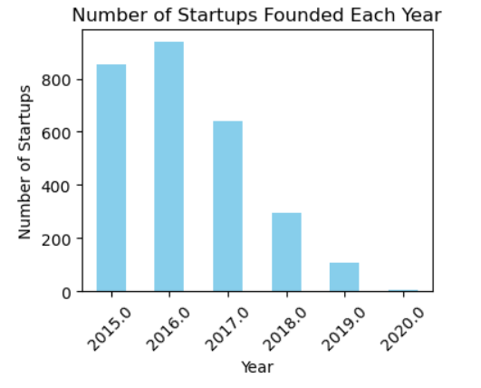
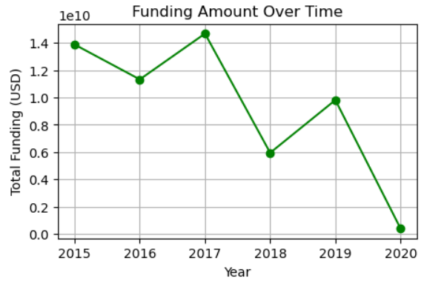
Start-ups and Funding Trends
Funding Over Time.
Number of Startups by Year
Bar chart showing startup growth over time.
2016 is the peak start-up activity years.
Line chart of total funding year-on-year.

Slide 5
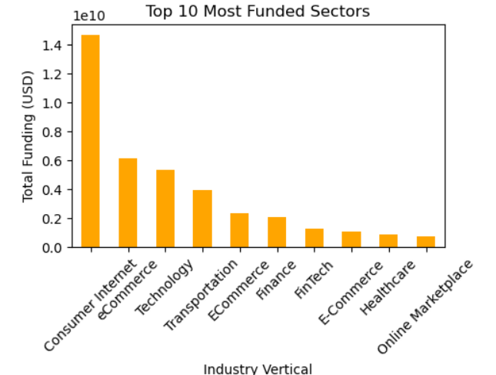
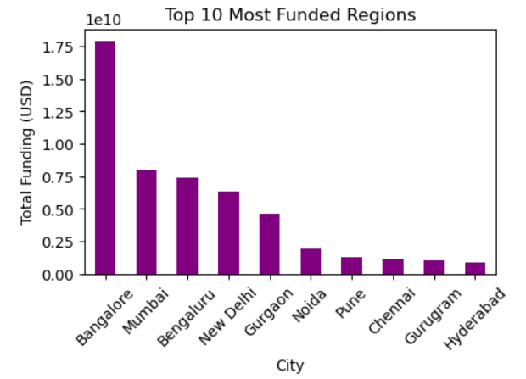
Industry and Regional Insights
Most Funded Industries
Most Funded Regions
Bar chart of top 10 industries by funding.
Bar chart of top 10 industries by Regions.

Slide 6
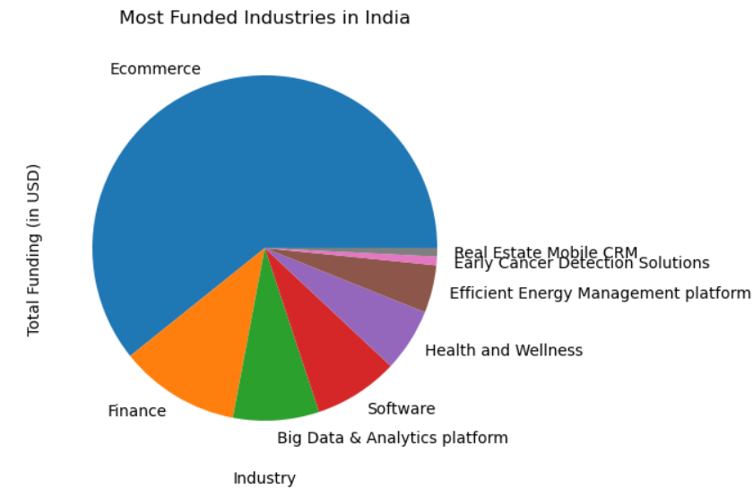
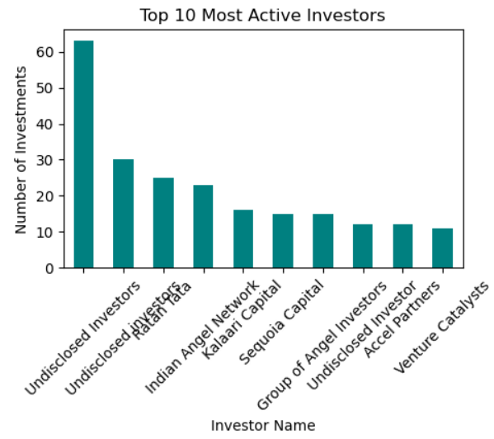
Most Active Investors
Investor Trends
Industries Most Funded in India
Bar chart of top 10 Investor Trends.

Slide 7
SQL Database Setup
Start-ups, Funding, Investors, Regions tables are created.
Total funding by sector.
Number of startups in each region
Top-funded industries over time.
Regional comparison of startup counts and funding.
Enable structured analysis for data-driven decision-making.

Slide 8
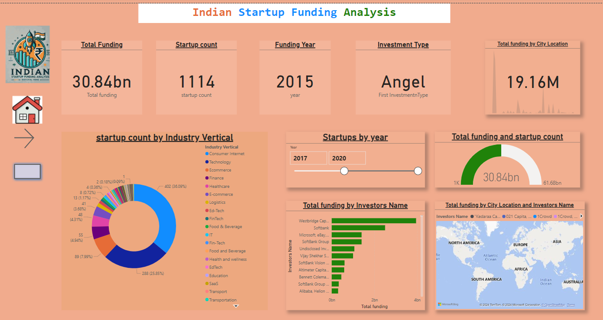
Power BI Analysis

Slide 9
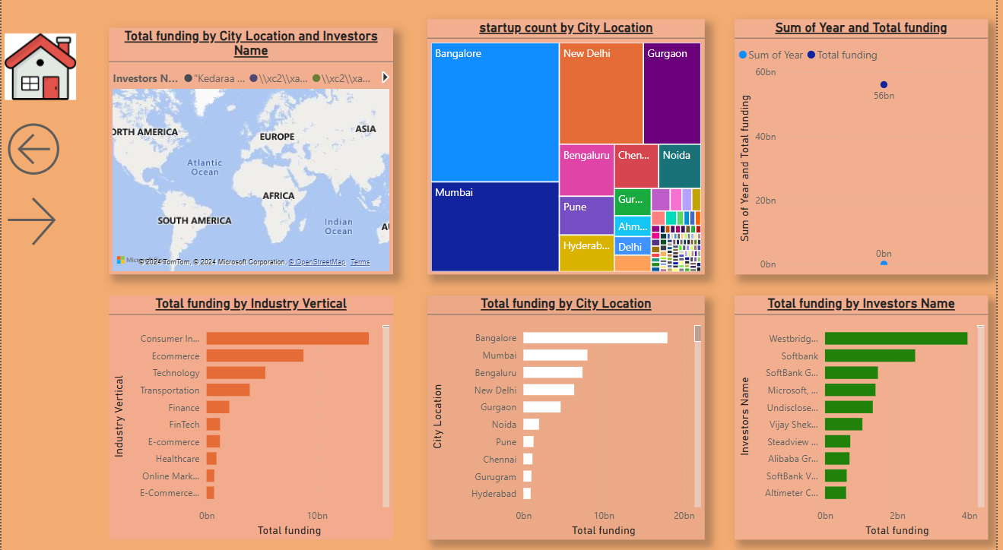
Start-up city Location Analysis

Slide 10
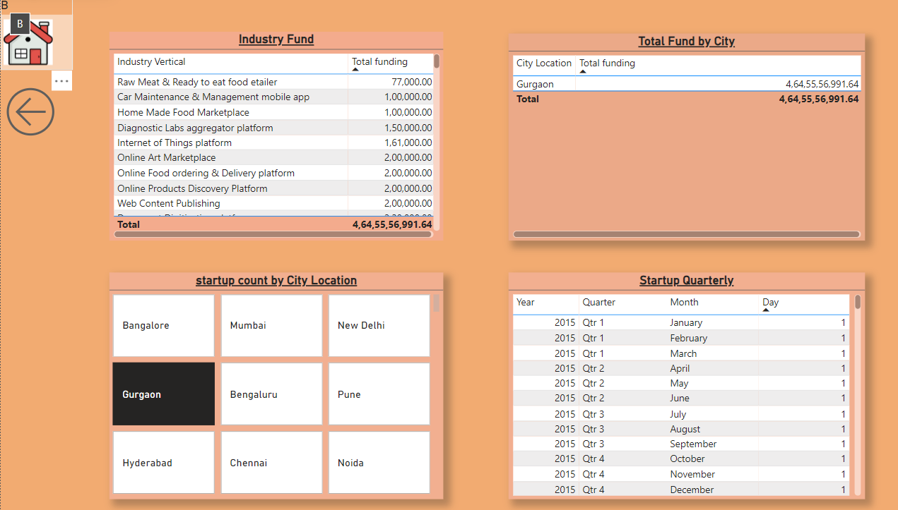
Tabular Data

Slide 11
Growth in startups and funding over years
Significant growth observed in the Indian startup ecosystem over the years.
Key industries like technology, e-commerce, and fintech dominate funding.
Major funding concentrated in regions such as Bengaluru, Delhi NCR, and Mumbai.
Leading investors focus on sectors with high growth potential.
Strategic investments in emerging industries and underrepresented regions can foster innovation and economic growth.
Data-driven insights and dashboards provide valuable tools for monitoring and decision-making.

Slide 12
Thank You

